Slide 1
Section 14.1
Counting
Copyright © 2012 Pearson Education, Inc. Publishing as Prentice Hall.

Slide 2
Copyright © 2012 Pearson Education, Inc. Publishing as Prentice Hall.

Slide 3

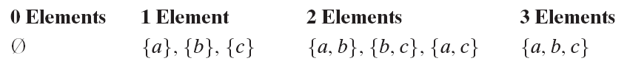
Copyright © 2012 Pearson Education, Inc. Publishing as Prentice Hall.

Slide 4
Copyright © 2012 Pearson Education, Inc. Publishing as Prentice Hall.

Slide 5
Copyright © 2012 Pearson Education, Inc. Publishing as Prentice Hall.

Slide 6
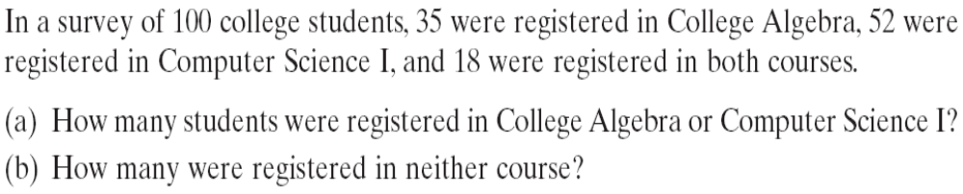

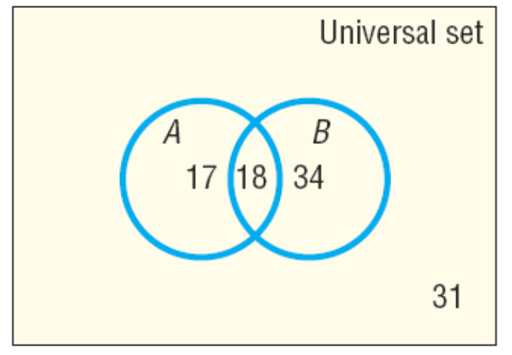
Those in Set A that are not in Set B = 35 – 18 = 17
Those in Set B that are not in Set A = 52 – 18 = 34
So total is 18 + 17 + 34 = 69 students.
Copyright © 2012 Pearson Education, Inc. Publishing as Prentice Hall.

Slide 7

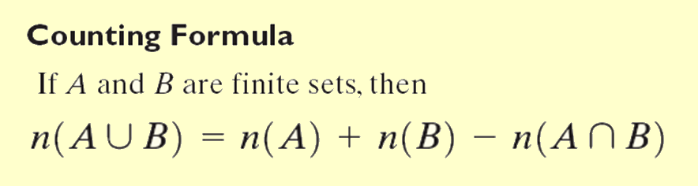
Copyright © 2012 Pearson Education, Inc. Publishing as Prentice Hall.

Slide 8
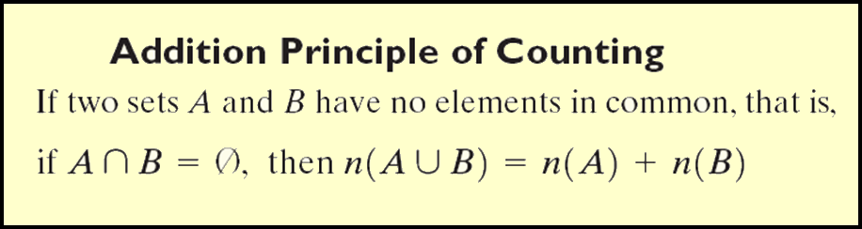
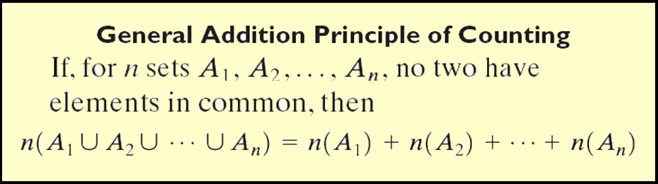
Copyright © 2012 Pearson Education, Inc. Publishing as Prentice Hall.

Slide 9

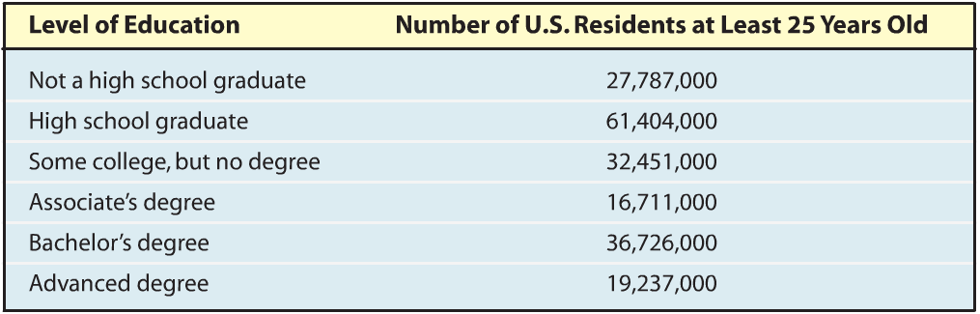
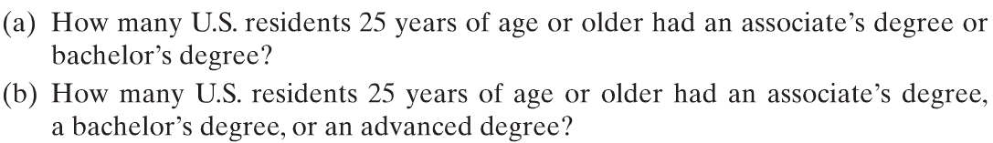

Copyright © 2012 Pearson Education, Inc. Publishing as Prentice Hall.

Slide 10
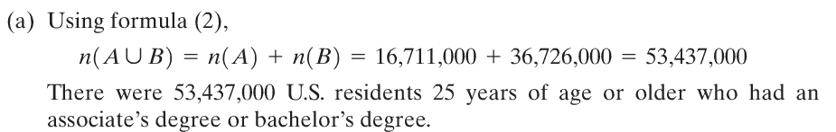
Copyright © 2012 Pearson Education, Inc. Publishing as Prentice Hall.

Slide 11
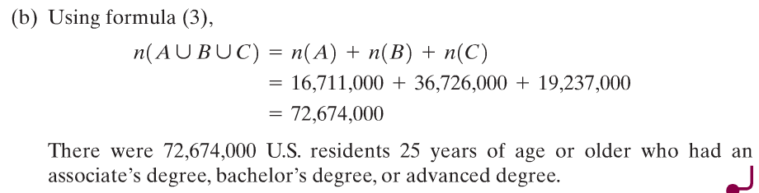
Copyright © 2012 Pearson Education, Inc. Publishing as Prentice Hall.

Slide 12
Copyright © 2012 Pearson Education, Inc. Publishing as Prentice Hall.

Slide 13
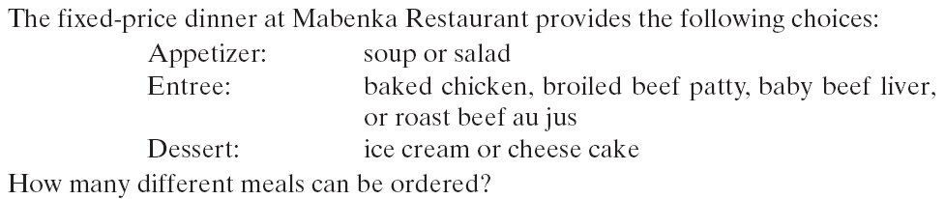
Copyright © 2012 Pearson Education, Inc. Publishing as Prentice Hall.

Slide 14
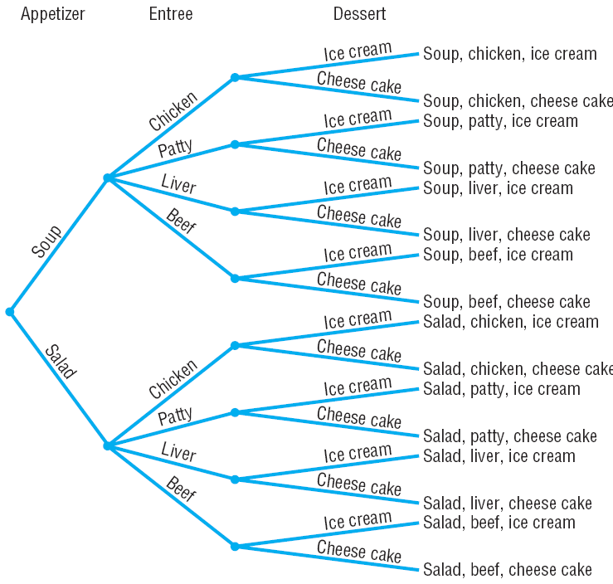
Copyright © 2012 Pearson Education, Inc. Publishing as Prentice Hall.

Slide 15
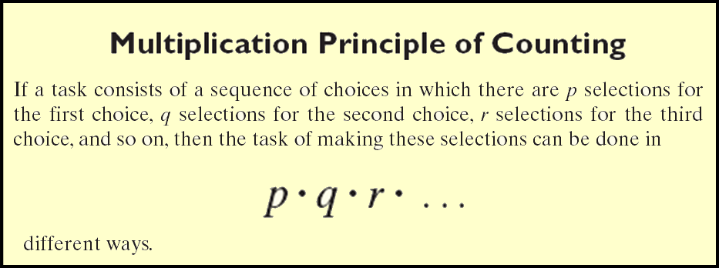
Copyright © 2012 Pearson Education, Inc. Publishing as Prentice Hall.

Slide 16

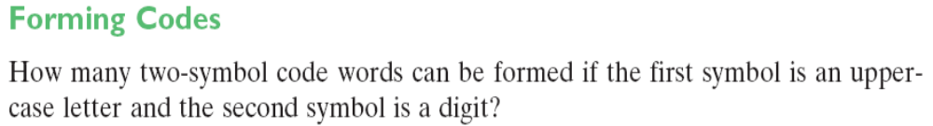
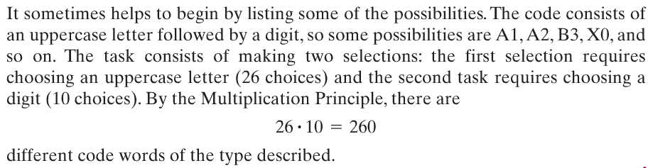
Copyright © 2012 Pearson Education, Inc. Publishing as Prentice Hall.

